Slide 1

Automatic Clothes Segregator.
Guide Name:Dr. Rashmi V. Patil
PBL V
ELECTRONICS & TELECOMMUNICATION ENGINEERING
Pimpri Chinchwad College of Engineering , Pune

Slide 2
TEAM MEMBERS
Sr. No. | Name | PRN No. | Roll No.
1 | Sanika C.Deshpande | 121B1E042 | TYETA42
2 | Yash S. Dhond | 121B1E044 | TYETA44
3 | Anuj K.Gavhane | 121B1E056 | TYETA56

Slide 3
CONTENT OF PROJECT
Sr. No. | Content
1 | Introduction
2 | Background and Motivation
3 | Objectives & Reengineering Concept used
4 | Flow Chart
5 | Circuit Design & Connections
6 | CAD Design
7 | Software & Hardware Requirements
8 | Advantages
9 | Limitations
10 | Future Scope
11 | Applications
12 | Conclusion
13 | Reference

Slide 4
INTRODUCTION TO PROJECT
Problem Statement
Sorting clothes according to their color becomes a hassle every time we put them in a washer.
By use of Automated Clothes Segregator, one can pile up all their clothes irrespective of their color and put them in the segregator instead of sorting them manually.
This will save a lot of time and energy of people

Slide 5
Background and Motivation
Need of Work / Reason for selection of this project:
A lot of people waste time and energy on sorting clothes every time while using a washer.
Issues like color fading, color bleeding occurs which stirs up unnecessary trouble.
Along with this, need to separately wash white or colored clothes which leads to water and electricity wastage with manual labor.

Slide 6
Objectives and Re-Engineering Concept Incepted
Objectives:
To sort clothes according to color.
Design a fully automated system to sort clothes.
Research about ways to implement it in normal washers/washing machines.
Reengineering Concept Incepted is:
The project re-engineers the garment sorting process by automating it using TCS3200 color sensors, reducing the need for manual labor and enhancing efficiency, accuracy, and garment care.

Slide 7
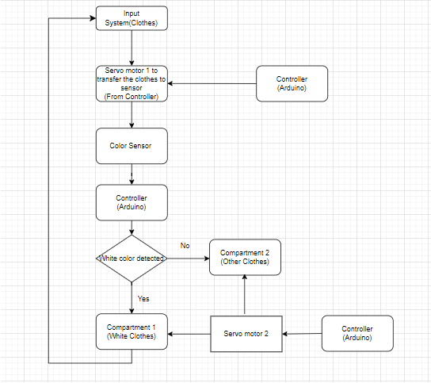
Flow Chart

Slide 8
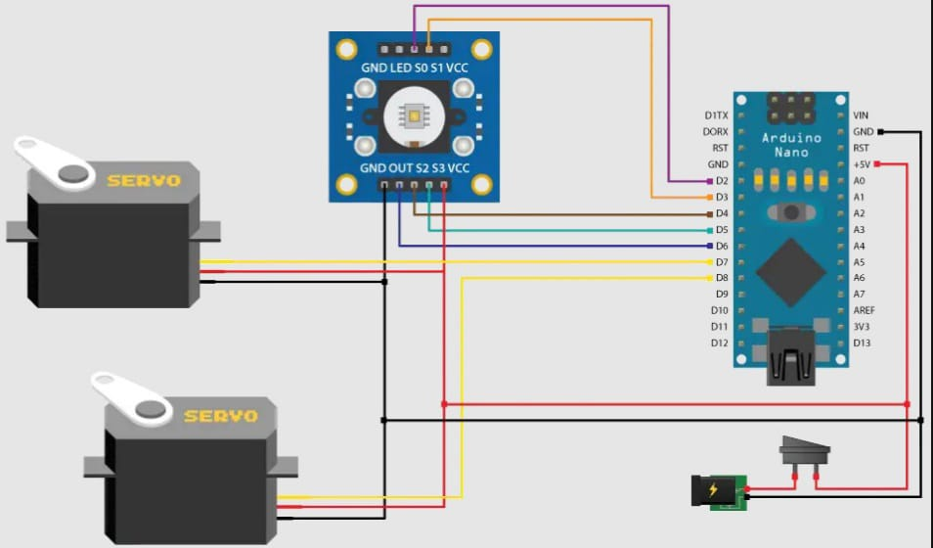
Circuit Design

Slide 9
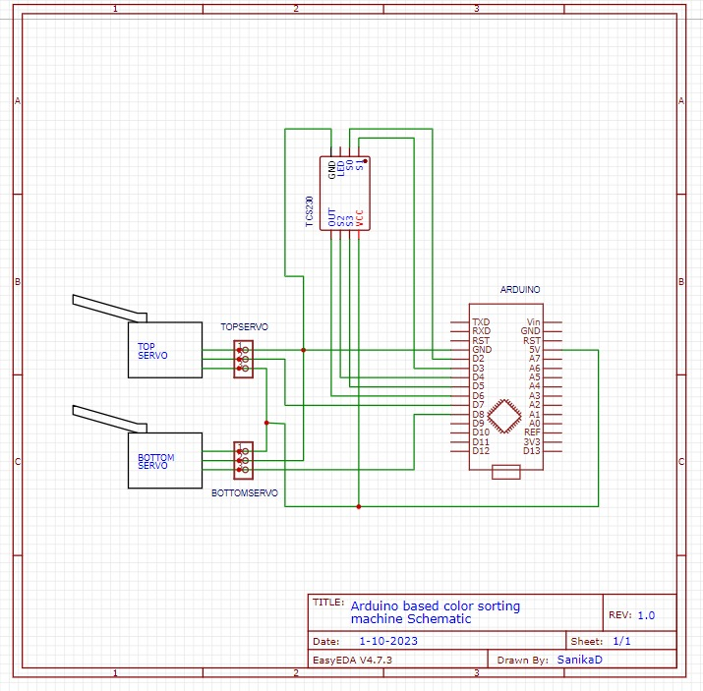
Connections

Slide 10
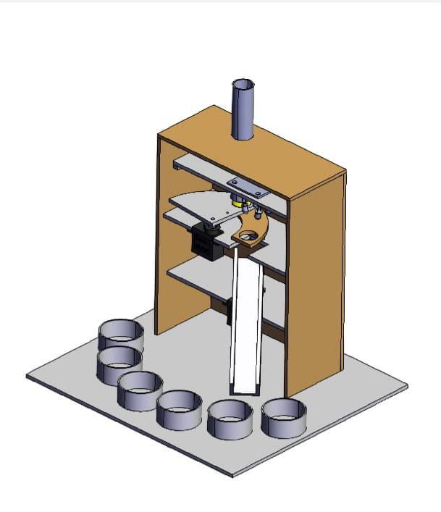
CAD Design 3D View

Slide 11
Software and Hardware Requirements
Software Requirements:
Proteus
Arduino IDE
CAD
EasyEDA V4.7.4
Hardware Requirements
SG 90 Servo motor
Power Jack
Switch
Arduino Nano
TCS3200 Color Sensor
Foam Board (2ft * 2ft)

Slide 12
Advantages
Color Preservation: Preventing color fading and bleeding in clothes helps maintain the quality and appearance of garments over time, ensuring customer satisfaction.
Non-Invasive Sorting: TCS3200 sensors are non-contact and gentle on the clothes, avoiding any physical damage or contamination during the sorting process.
High Accuracy: TCS3200 sensors are capable of accurate color detection, reducing the chances of misclassification and errors.
Efficiency: Automating the sorting process with these sensors can significantly increase the speed and efficiency of garment sorting.
Customization: You can easily customize the color detection thresholds and sorting criteria to meet specific needs, such as sorting clothes by shade or fabric type.
Reduced Labor Costs: Automated sorting machines can reduce the need for manual sorting, saving on labor costs.

Slide 13
Limitations
Limited Color Range: TCS3200 sensors may struggle to differentiate extremely similar shades, leading to misclassification.
Light Sensitivity: Variations in ambient lighting can affect the sensor's accuracy. Controlled lighting may be required.
Calibration Challenges: Accurate calibration is essential for precise color detection and requires ongoing maintenance.
Environmental Factors: Dust and dirt can affect the sensor's performance, necessitating regular cleaning and maintenance.
Material Compatibility: TCS3200 sensors work best with solid-colored or opaque materials. They may not be ideal for sorting transparent or highly reflective fabrics.

Slide 14
Future Scope
Machine Learning Integration: Incorporating machine learning algorithms can enhance the accuracy of color detection, especially for subtle color variations. Deep learning models can be trained to recognize a wider range of colors and patterns.
Multi-Sensor Fusion: Combining TCS3200 sensors with other sensor types, such as infrared sensors or computer vision systems, can improve overall garment sorting accuracy.
Wearable Tech Integration: Future applications could involve integrating color detection technology into wearable devices, allowing users to check and sort their clothing with ease.
Smart Home Integration: Integration with smart home systems can enable automated garment sorting and care instructions based on color, fabric type, and garment care labels.

Slide 15
Applications
In washing machines to reduce human effort.
Laundry industry.
In industries based on color sorting.
In textile recycling industry.

Slide 16
Conclusion
Successfully implemented the Automatic Clothes Segregator project using TCS3200 Color Sensor ,Arduino Nano and SG 90 Servo motors.
Designed the circuit using online software EasyEDA V4.7.4 and Proteus and learned its minor details.
Designed the body of project using CAD software and implemented it using foam board and card board material.
We studied and re-engineered the process of sorting objects based on color and tried to implemented it in the laundry, textile manufacturing industry and recycling industry.

Slide 17
References
https://www.elecrow.com/wiki/index.php?title=TCS3200_Colour_Sensor_Module#:~:text=TCS3200%20converts%20the%20intensity%20of,is%20available%20in%20single%20line
https://www.researchgate.net/publication/360146509_Development_of_Arduino_Uno-Based_TCS3200_Color_Sensor_and_Its_Application_on_the_Determination_of_Rhodamine_B_Level_in_Syrup
https://www.researchgate.net/publication/341161348_Design_and_Development_of_Product_Sorter_Using_TSC3200_Color_Sensor
https://www.researchgate.net/publication/340264241_Prediction_of_Nutrients_N_P_K_in_soil_using_Color_Sensor_TCS3200

Slide 18


